Slide 1


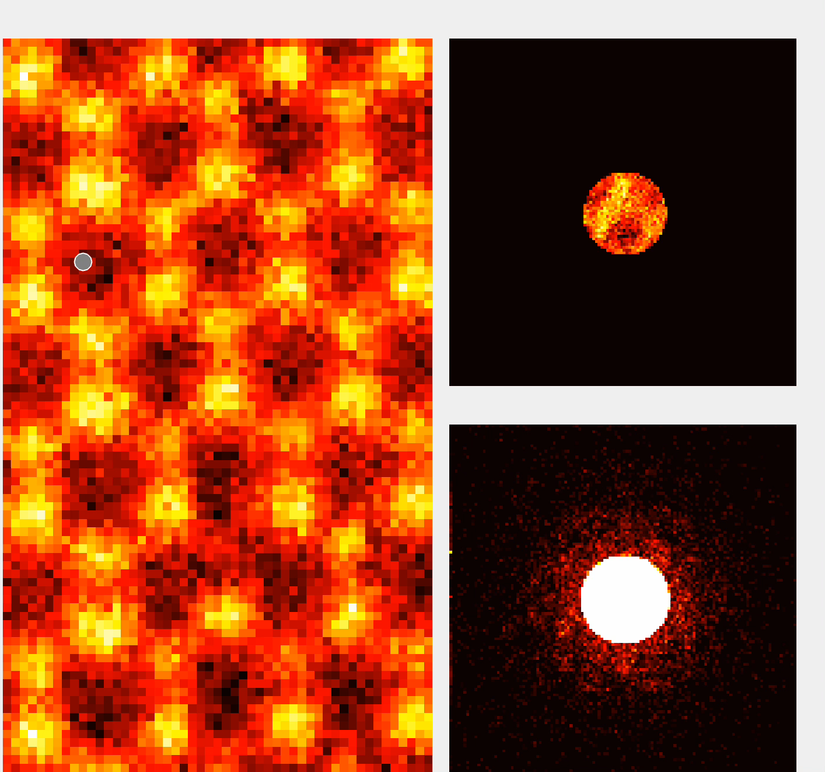
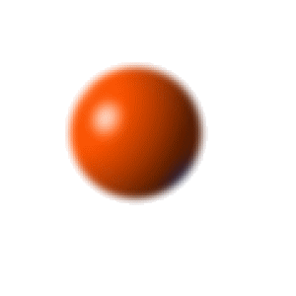
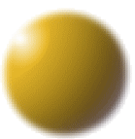

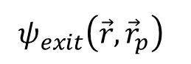
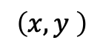
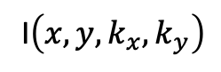
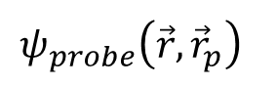
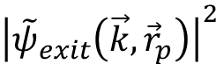
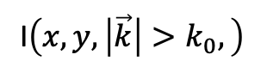
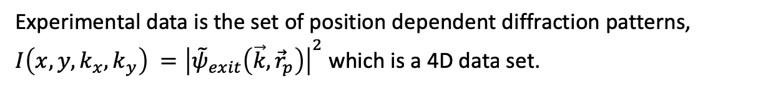
Four-dimensional Scanning Transmission electron microscopy (4D-STEM)
Experimental data is the set of position dependent diffraction patterns,
$I\left(x,y,k_{x},k_{y}\right) ={\left|{\tilde{ψ}}_{exit}\left(\vec{k},{\vec{r}}_{p}\right)\right|}^{2}$ which is a 4D data set.
Electron gun
Lenses
Diffraction Pattern at at given (x,y):
I$\left(x,y,\left|\vec{k}\right|>k_{0},\right)$
I$\left(x,y,k_{x},k_{y}\right)$
$$ψ_{probe}\left(\vec{r},{\vec{r}}_{p}\right)$$
Diffraction pattern has a huge range
of intensities so we split it into
Central disk (top)
And scattered signal (bottom)
$$\left(x,y \right)$$
Sample
$$ψ_{exit}\left(\vec{r},{\vec{r}}_{p}\right)$$
Fourier transform
EMPAD
$${\left|{\tilde{ψ}}_{exit}\left(\vec{k},{\vec{r}}_{p}\right)\right|}^{2}$$
General Goal is to solve the inverse problem: Given the scattered distribution I$\left(x,y,k_{x},k_{y}\right)$, find the scattering potential.
This can be thought of as a classification problem: The nuclear charge distributions are delta functions. In 2D (x,y) there are 3 types of nuclei: Mo, S, and “S₂”. If we train on the top half of the image, (just Mo & S2, can we find the missing S at the bottom?

Slide 2
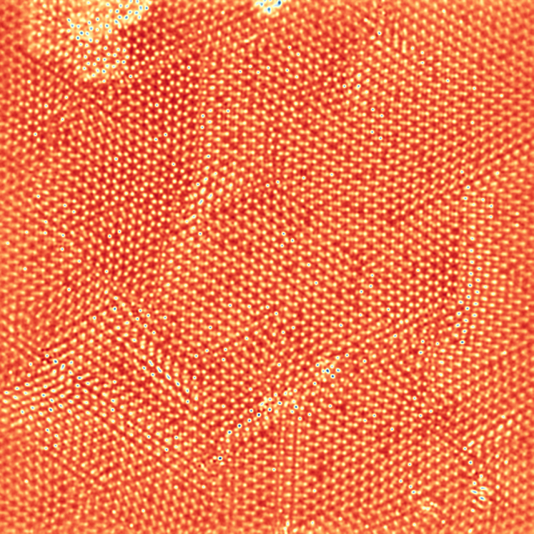
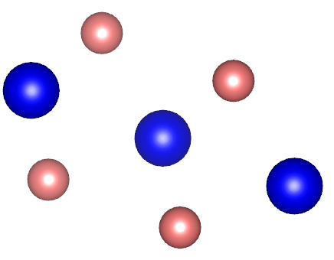
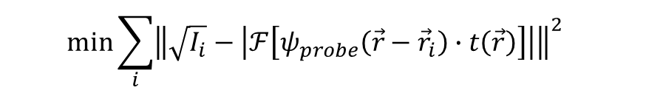
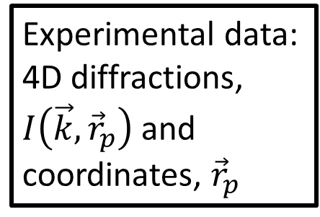
What we can get from the 4D diffraction?
More complex case: MoS₂ tilt and atomic displacement
Atomic positions and defect
Can we classify the atoms and positions?
Experimental data:
4D diffractions, $I\left(\vec{k},{\vec{r}}_{p}\right)$ and coordinates, ${\vec{r}}_{p}$
data analysis
optimization
$$\text{m}\text{in}{\sum_{i}{{\left\|\sqrt{I_{i}}−\left|ℱ\left[ψ_{probe}\left(\vec{r}−{\vec{r}}_{i}\right)∙t\left(\vec{r}\right)\right]\right|\right\|}^{2}}}$$
Can we use machine learning instead?
Mo
2 nm
S
We have an algorithm that works for thin samples. It does not work for thick ones, but ML classification should.

